Slide 1


Network protocols & security
24EC2210
Topic:
IPv4 and IPv6 Headers
Session – 16&17

Slide 2



AIM OF THE SESSION
To familiarize students with the IPv4 and IPv6 header formats.
INSTRUCTIONAL OBJECTIVES
This Session is designed to:
Describe the responsibilities of IP protocol.
Describe the fields of IPv4 header.
Describe the fields of IPv6 header.
LEARNING OUTCOMES
At the end of this session, you should be able to:
Illustrate the header formats of IPv4 and IPv6.
Understand the importance of each field in IPv4 and IPv6 headers.

Slide 3
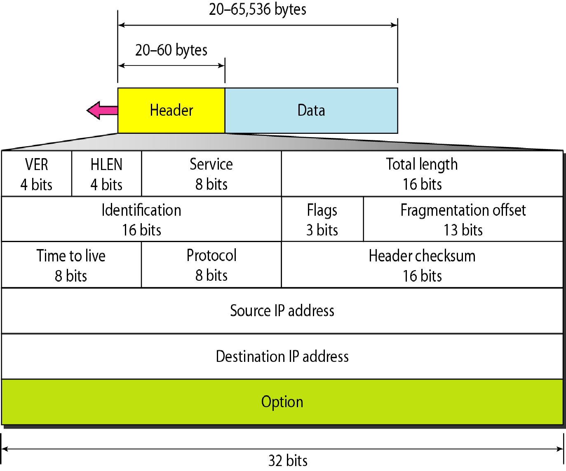
IPv4 datagram format

Slide 4
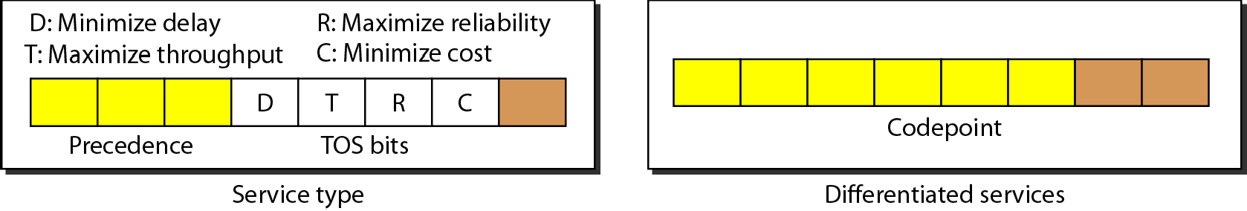
Service type or differentiated services

Slide 5
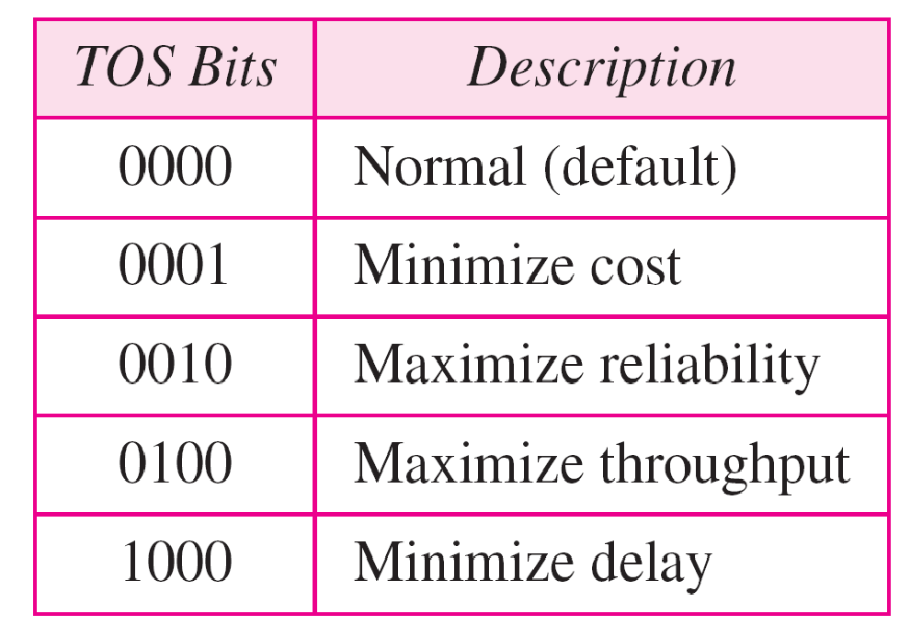
Types of service

Slide 6
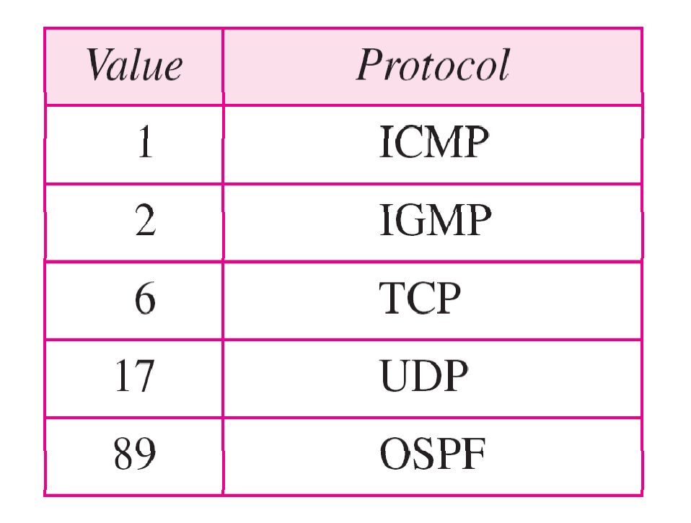
Values for codepoints

Slide 7
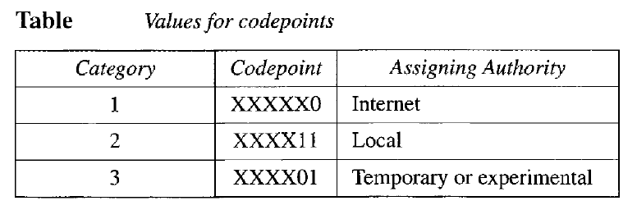

Slide 8
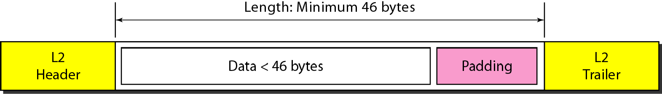
Encapsulation of a small datagram in an Ethernet frame

Slide 9
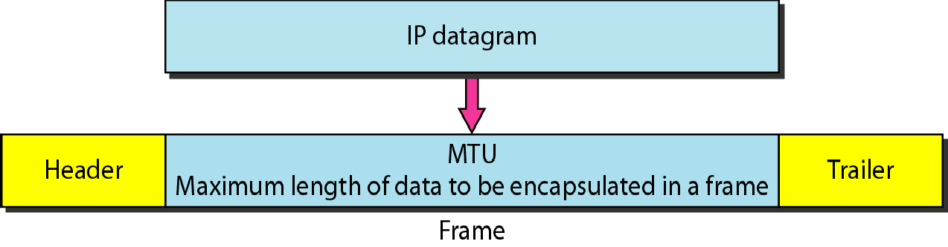
Figure Maximum transfer unit (MTU)

Slide 10
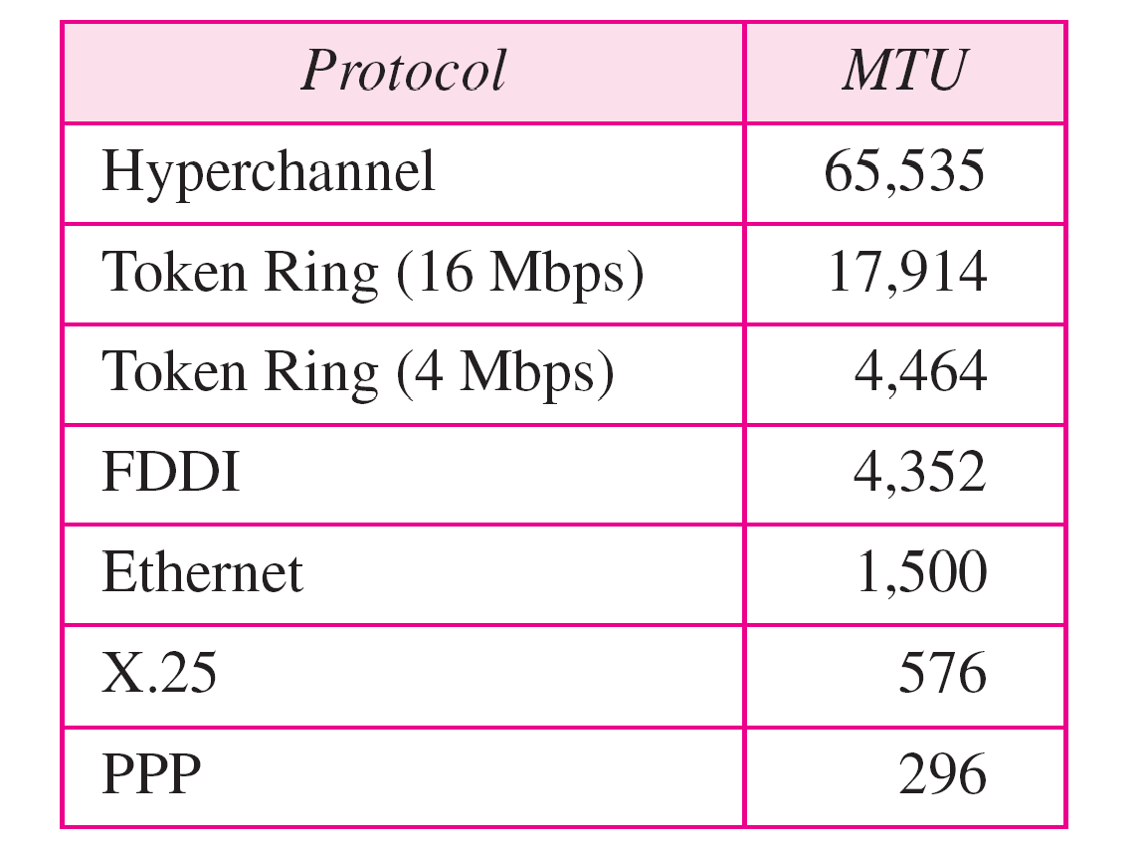
MTUs for some networks

Slide 11

Flags used in fragmentation

Slide 12
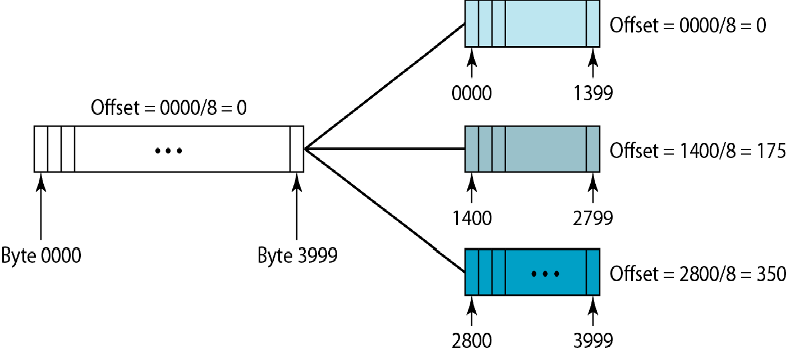
Fragmentation example

Slide 13
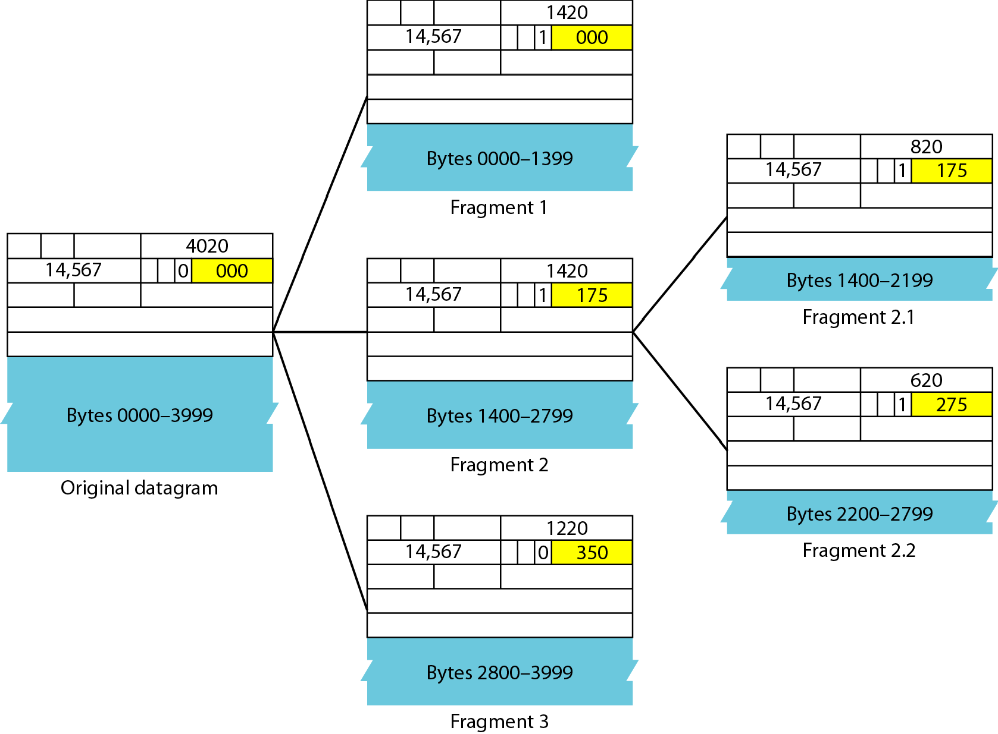
Detailed fragmentation example

Slide 14
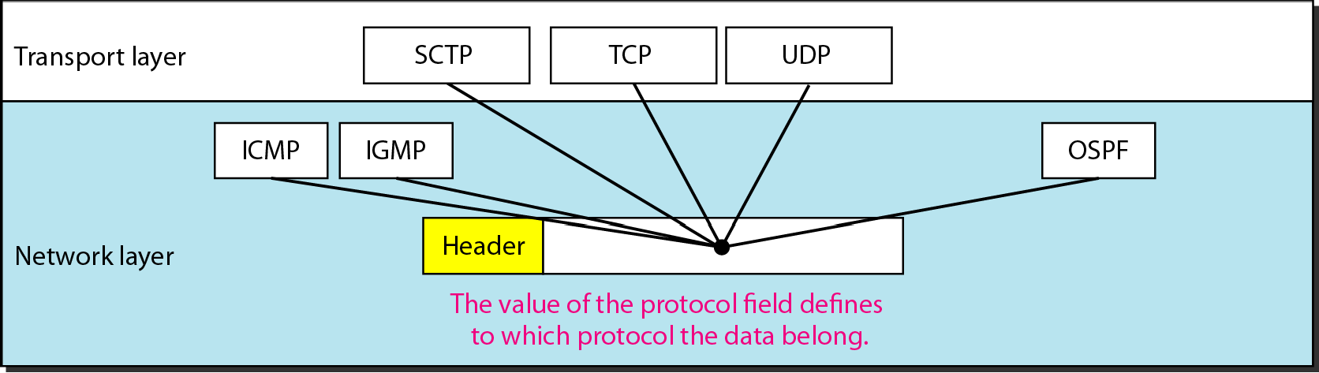
Protocol field and encapsulated data

Slide 15
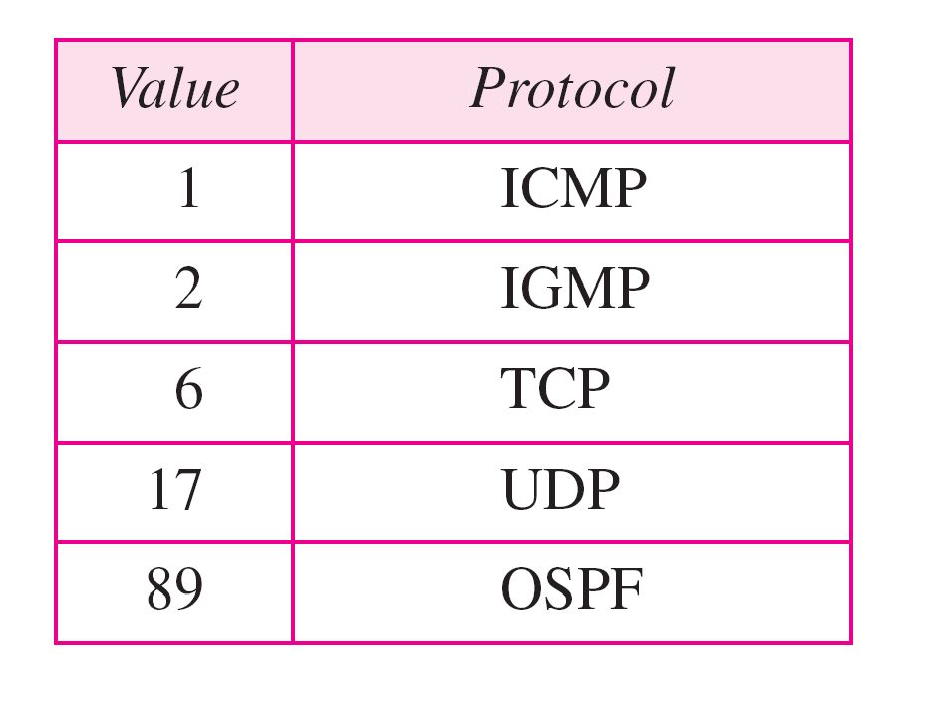
Protocol values

Slide 16
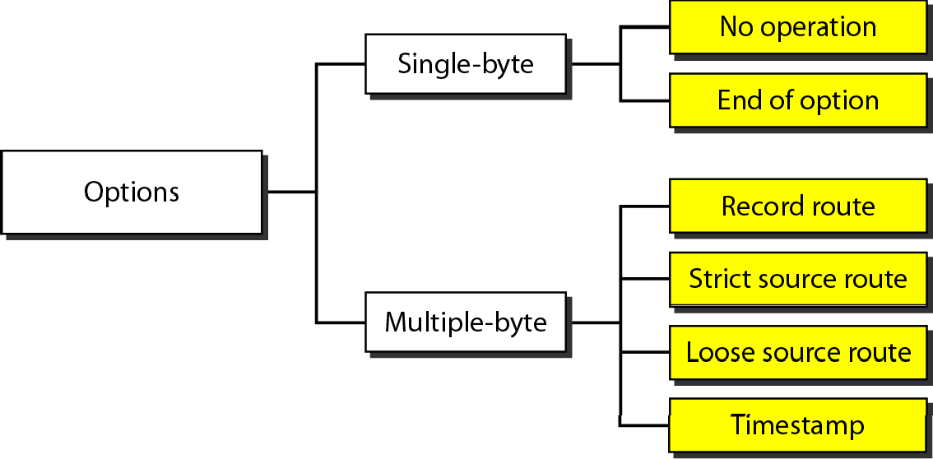
Taxonomy of options in IPv4

Slide 17
IPV6
Despite all short-term solutions, address depletion is still a long-term problem for the Internet. This and other problems in the IP protocol itself have been the motivation for IPv6.
An IPv6 address is 128 bits long

Slide 18
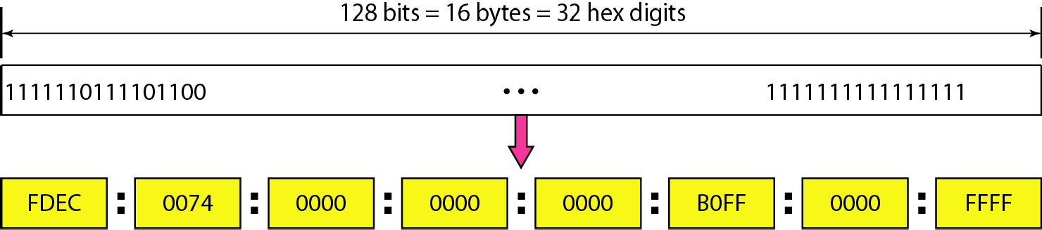
IPv6 address in binary and hexadecimal colon notation

Slide 19
The leading zeros of a section (four digits between two colons) can be omitted. Only the leading zeros can be dropped, not the trailing zeros

Slide 20
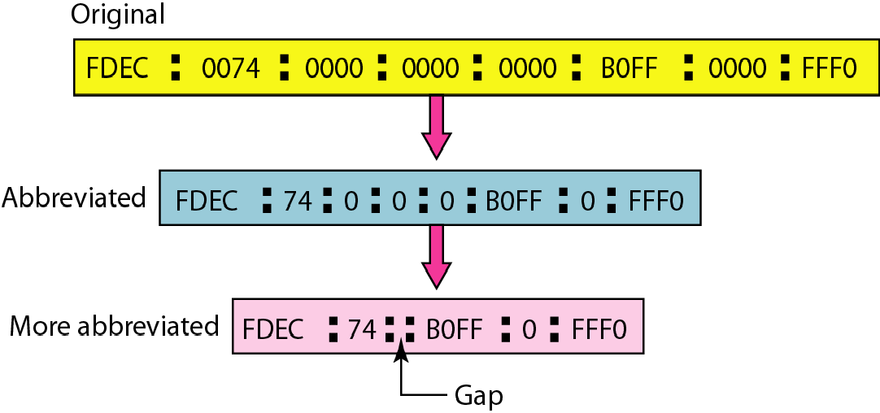
Abbreviated IPv6 addresses

Slide 21
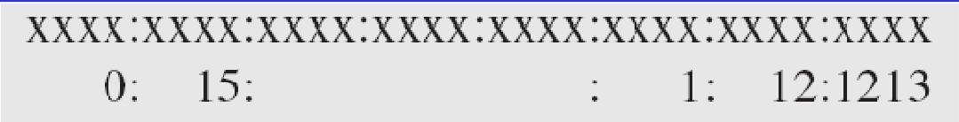
Expand the address 0:15::1:12:1213 to its original.
Solution
We first need to align the left side of the double colon to the left of the original pattern and the right side of the double colon to the right of the original pattern to find how many 0s we need to replace the double colon.
This means that the original address is.

Slide 22
IPv6
The network layer protocol in the TCP/IP protocol suite is currently IPv4. Although IPv4 is well designed, data communication has evolved since the inception of IPv4 in the 1970s. IPv4 has some deficiencies that make it unsuitable for the fast-growing Internet..
Topics discussed in this section:
Advantages Packet Format Extension Headers

Slide 23
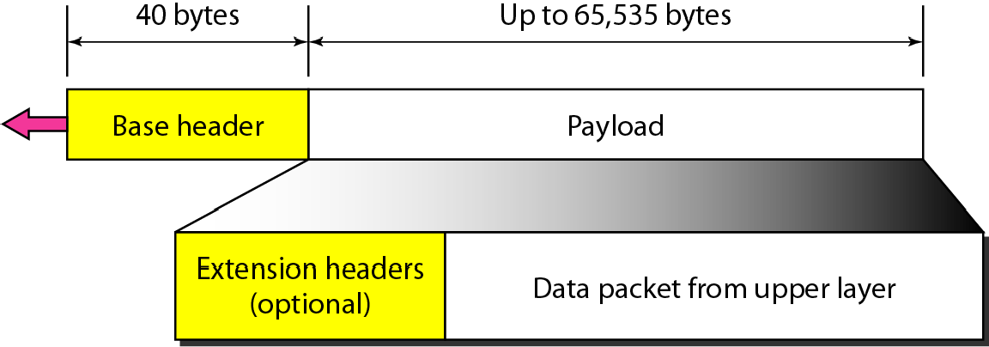
IPv6 datagram header and payload

Slide 24
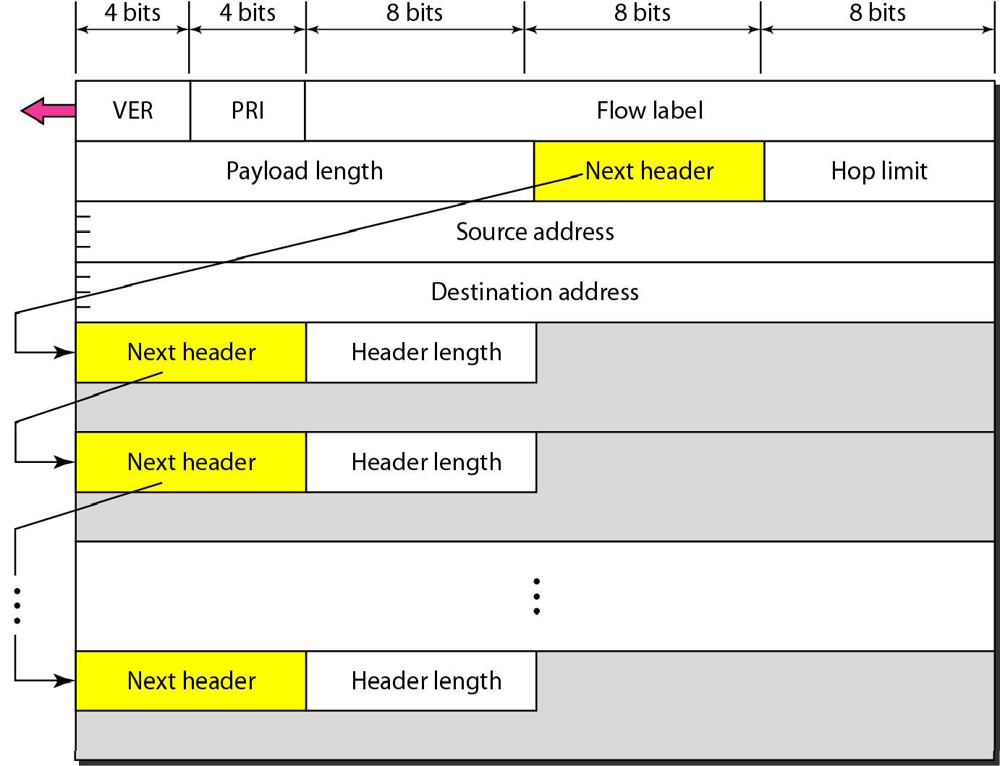
Format of an IPv6 datagram

Slide 25
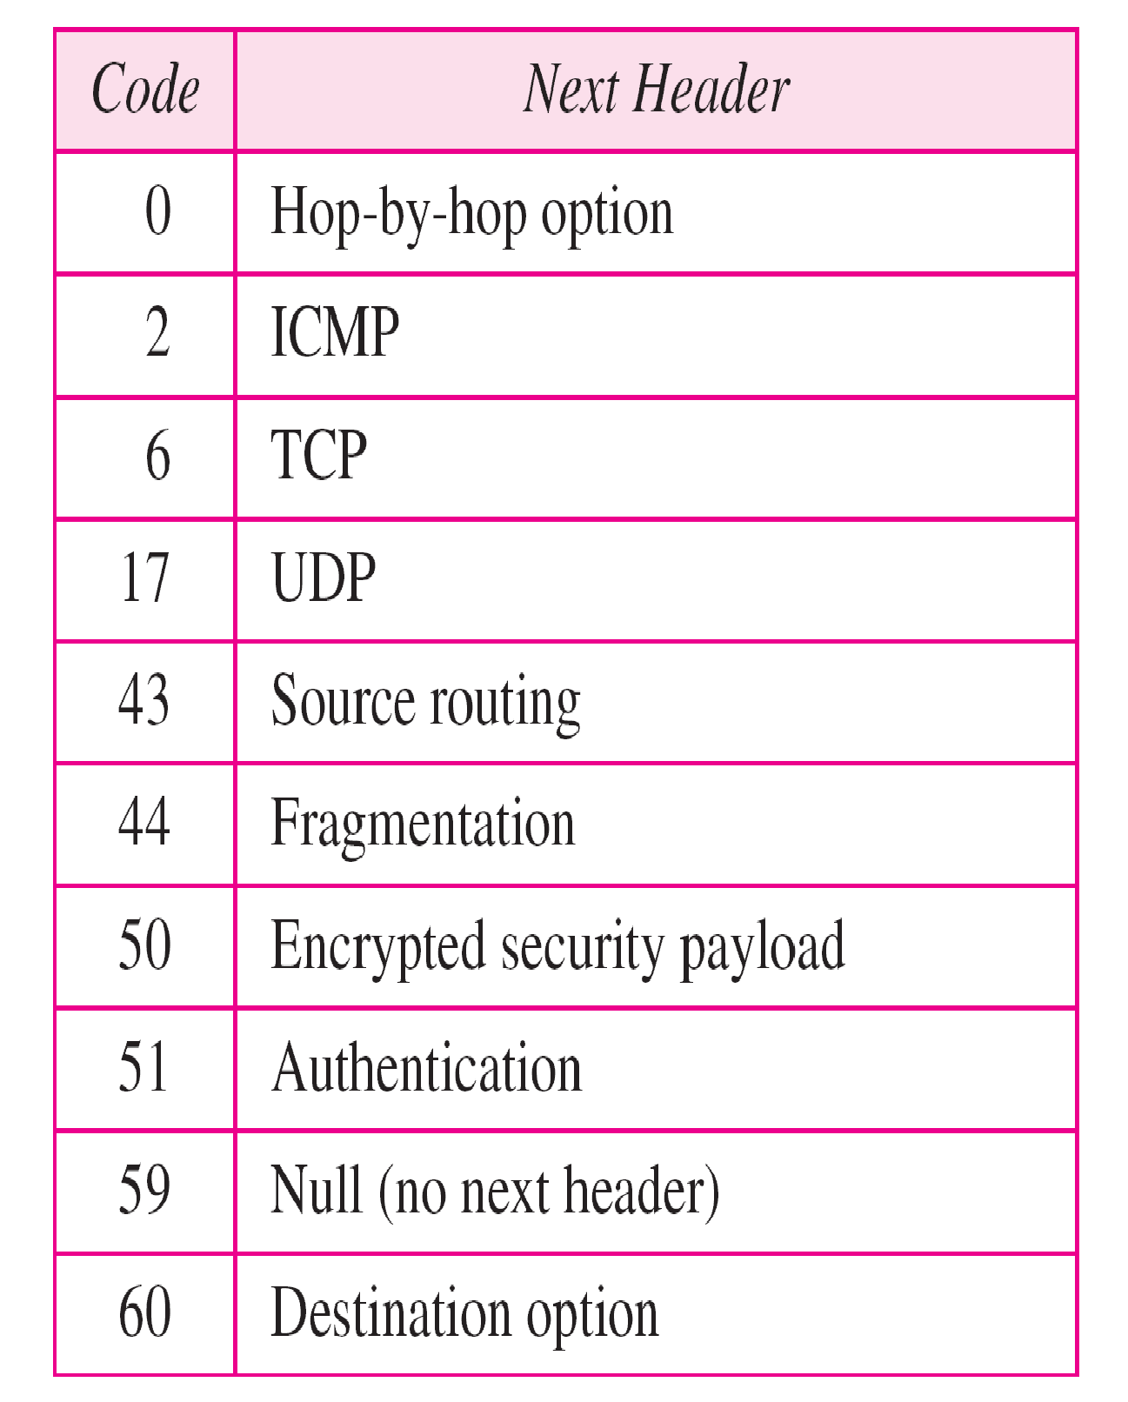
Next header codes for IPv6

Slide 26
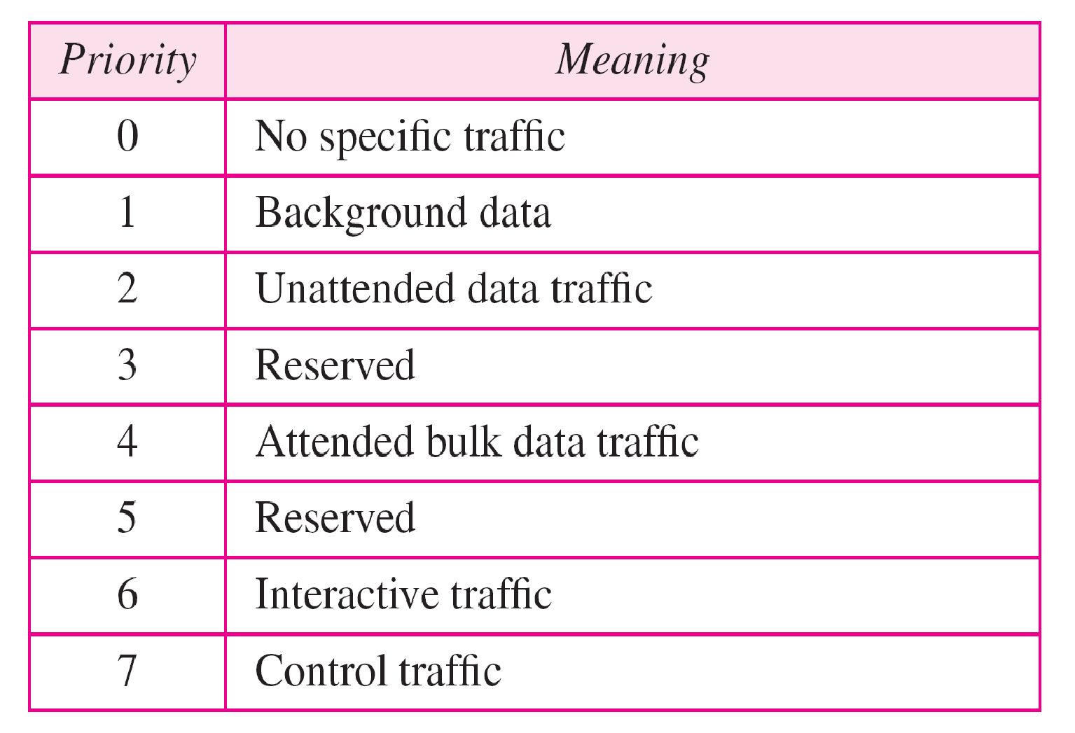
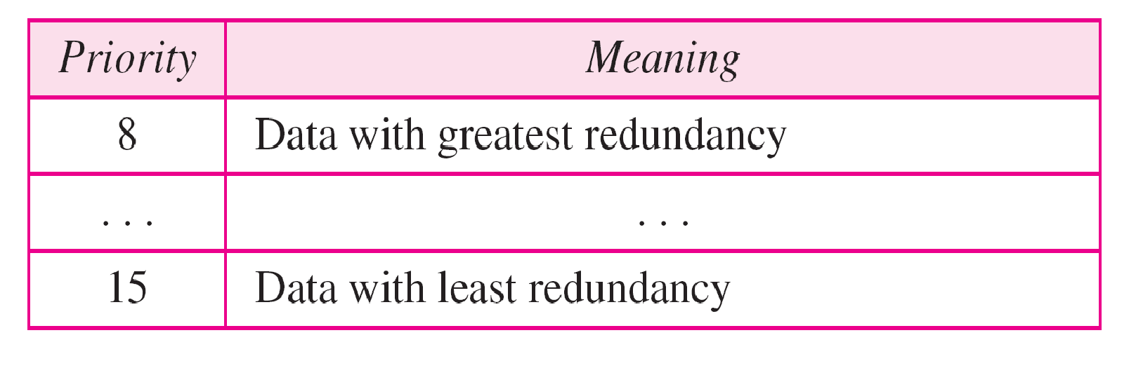
Priorities for congestion-controlled traffic

Slide 27
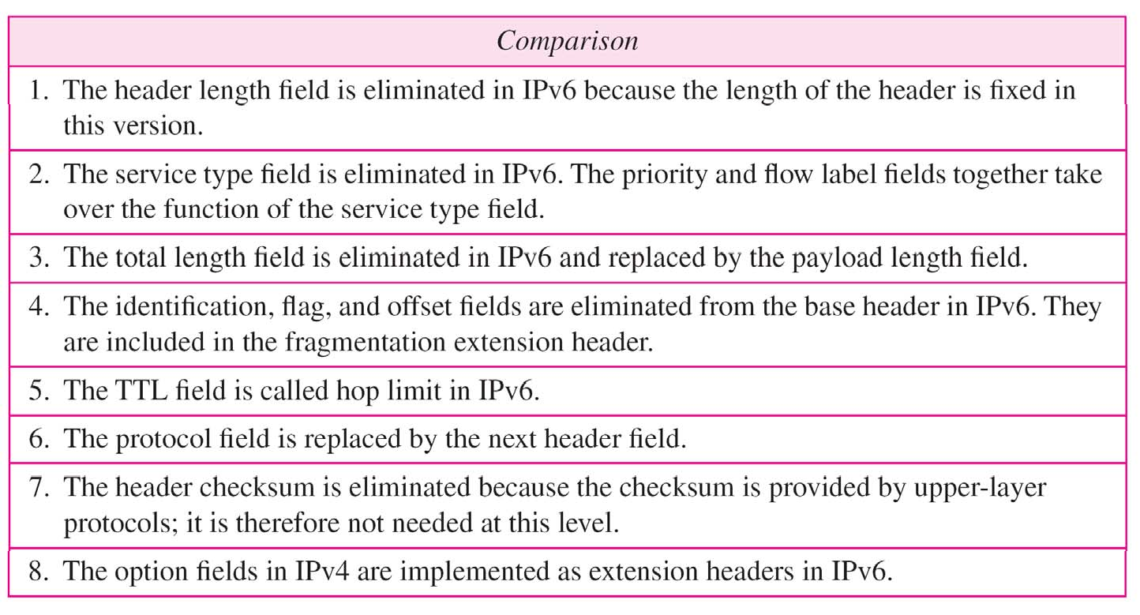
Comparison between IPv4 and IPv6 packet headers

Slide 28
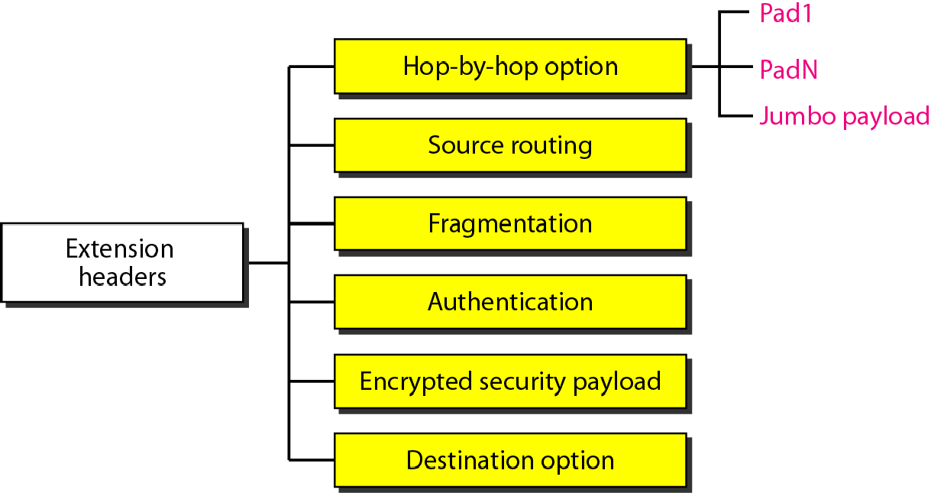
Extension header types

Slide 29
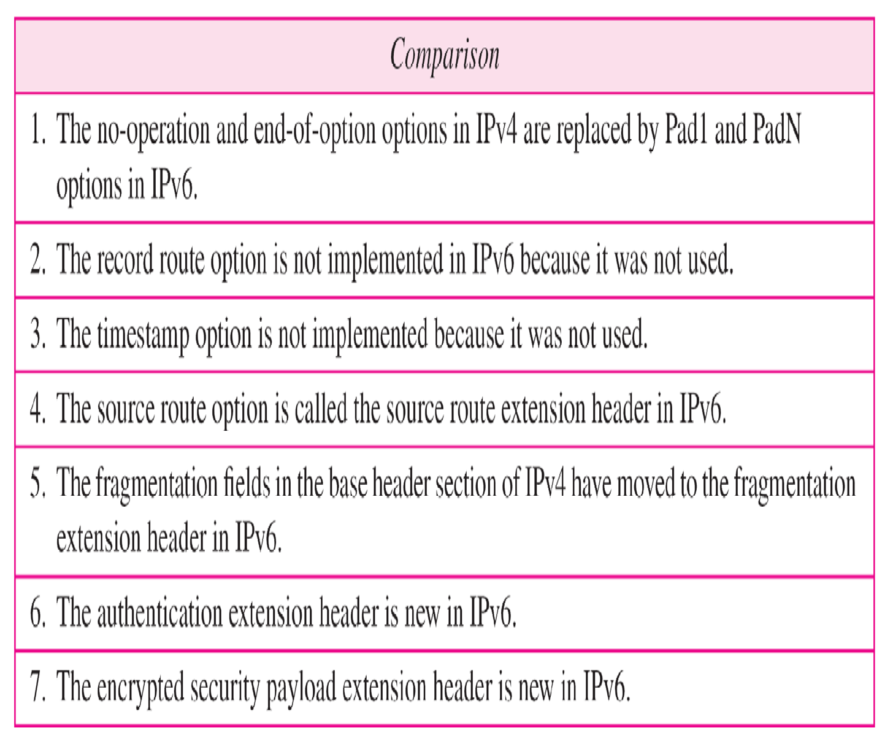
Comparison between IPv4 options and IPv6 extension headers

Slide 30

SUMMARY
IPv4 Header format
IPv6 Header format

Slide 31
TERMINAL QUESTIONS
1. With a neat sketch describe the fields of IPv4 header.
2. With a neat sketch describe the fields of IPv6 header.

Slide 32
REFERENCES FOR FURTHER LEARNING OF THE SESSION
Reference Books:
Behrouz A. Forouzan , “Data Communication and Networking”, TMH, 5th Edition, 2012.
A.S. Tanenbaum, David J. Wetheral “Computer Networks” Pearson, 5th Edition.

Slide 33
THANK YOU
Team – Network Protocols & Security

